Slide 1

Harness Engineering
The New Engineering Paradigm for Building Reliable AI Agents
Presenter: AI Assistant | June 2026
Notes:
大家好，今天我将为大家介绍AI工程领域的最新范式——Harness Engineering。随着AI从简单的对话助手演变为能够自主执行复杂任务的智能体，我们如何确保其在生产环境中的可靠性、安全性和可维护性？本次分享将深入探讨AI工程的演进历程，并详细解析Harness的核心架构，为构建下一代AI应用提供全面的工程实践指南。

Slide 2

CONTENTS
01
02
03
The Evolution of AI Engineering: From Instruction to Environment
Harness Engineering: Core Architecture
Summary and Outlook
Reviewing the evolution from Prompt Engineering instruction optimization, to Context Engineering context construction, and finally to the systematic engineering paradigm of Harness Engineering.
An in-depth analysis of the Overview of the Three-Layer Model ("Model Layer-Framework Layer-Application Layer"), and a Detailed Explanation of the Six Core Components such as Prompt and Context.
Reviewing the Review of Core Ideas of Harness Engineering, exploring Future Trends in AI engineering, and the implementation challenges and opportunities in practical business scenarios.
以系统化思维重构AI应用开发流程，让智能技术从实验走向可靠、可复用的工程实践。
Notes:
本次分享将分为三个部分。首先，我们将回顾AI工程从Prompt到Context，再到Harness的演进历程。接着，我们将深入剖析Harness Engineering的核心架构和六大组件。最后，进行总结并展望未来趋势。

Slide 3
01
The Evolution of AI Engineering
The technological leap from optimizing individual instructions to building a full-stack intelligent environment.
Notes:
让我们进入第一部分，探讨AI工程是如何从最初的指令优化，一步步演变为构建完整运行环境的。

Slide 4




Prompt Engineering (2022-2024): The Art of Conversing with AI
Core Definition: The 'Instruction Manual' for Guiding AI
Core Strategy: Optimizing Expression and Applying Techniques
As the first stage of AI engineering, its core is to guide the model to generate high-quality outputs through well-designed instructions (Prompts), ensuring the model's reasoning and output align with expectations.
Focus on precise intent expression, using techniques like Chain-of-Thought and Few-shot examples to enhance the model's performance and output quality.
Analogy: Giving Exam Questions to a Student
Inherent Limitation: The Fragility of Soft Constraints
Similar to a teacher designing exam questions, the goal of a Prompt engineer is to create the clearest questions to stimulate the model's potential.
Effectiveness is highly dependent on the model's understanding. The model may 'forget' or 'ignore' instructions, making it fragile for complex tasks.
Notes:
我们首先来看AI工程的第一个阶段：Prompt Engineering。这个阶段的核心是“如何说”，即通过优化指令来引导AI。我们运用各种技巧，如思维链、角色扮演等，希望模型能给出完美答案。这就像老师给学生出题，力求题目清晰。但这种方式的局限性也很明显，它依赖模型的“软性”理解，在复杂任务中不可靠。

Slide 5




Context Engineering (2025): The Craft of Informing AI
01 / Core Definition: Answering 'What the Model Needs to Know'
Information Asset Management
Retrieval-Augmented Generation (RAG)
The second stage of AI engineering, pioneered by experts like Andrej Karpathy, focuses on constructing and managing the contextual information the model needs during inference.
Managing all content within the context window, including documents, conversation history, and tool definitions.
Retrieving relevant information from external knowledge bases to reduce hallucinations and provide up-to-date knowledge.
Analogy: Providing a 'Map and Reference Books' to a Student
Context Window Optimization: Combating 'Lost in the Middle'
Context engineers ensure the model has all necessary information to solve problems, just like providing a student with a map and reference materials.
Addressing issues like 'Lost in the Middle' to ensure key information is effectively utilized by the model.
EXAMPLE: Customer Support | Key Limitation:While Context Engineering solves knowledge 'breadth', it fails to guarantee behavioral reliability. Even with correct info, the model may not use it properly. In customer support, this means precise troubleshooting guides (injected as context) are needed to ensure accurate, step-by-step responses (e.g., "Clean battery contacts first") instead of generic advice.
Notes:
This slide introduces Context Engineering (2025), the craft of informing AI. We cover its core definition, an analogy to providing a student with maps/books, key practices like Information Asset Management, RAG, and Context Window Optimization. We also highlight a critical limitation: it solves knowledge breadth but not behavioral reliability. An example in customer support shows how injecting precise context (e.g., A08 vacuum specs) enables accurate, step-by-step responses.

Slide 6
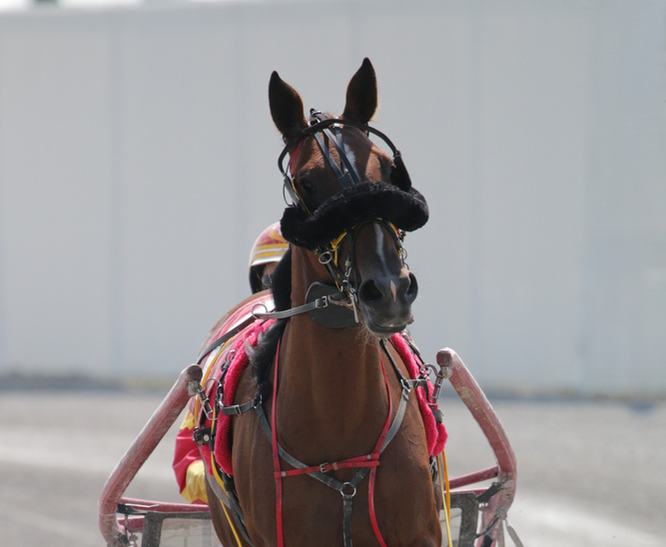



Harness Engineering (2026-Present): The Engineering of Building AI's Operating Environment
Harness Engineering（驾驭工程）是AI工程的第三个前沿阶段。它专注于构建围绕AI模型的完整运行时环境（Harness），从根本上确保AI行为的可靠性、安全性、可审计性与全生命周期的可维护性。
System Design
Constraints & Validation
Full Lifecycle Management
Designing deterministic frameworks to control AI behavior, moving away from relying on its probabilistic outputs.
Enforcing rules through code (hard constraints) and establishing automated validation and repair mechanisms.
Covering the entire process of an AI Agent from task reception, planning, execution, to result output.
Analogy: Equipping a Thoroughbred with a Full Harness The goal is not to make the horse run faster, but to ensure it runs safely and steadily on the correct track, following the rider's commands.
Key Shift:From 'Conversing with AI' to 'Building Reliable Software Systems with AI', establishing engineered trust.
Notes:
这就引出了我们今天的主角——Harness Engineering。它不再关注“怎么说”或“给什么”，而是关注“在什么系统里干活”。它为AI构建一个完整的运行环境，就像为千里马配备全套马具。我们的目标不再是让AI更聪明，而是让它更可靠、更安全。这标志着AI工程从“与AI对话”转向“用AI构建可靠的软件系统”。

Slide 7
Three Generations of Evolution: From Instruction to Environment
01 Prompt Engineering
02 Context Engineering
03 Harness Engineering
Core Question & Management:How to express instructions clearly? Optimize single-turn interaction quality.
Core Question & Management:How to provide sufficient information? Optimize context window management.
Core Question & Management:How to stabilize behavior and ensure reliability? Manage the full lifecycle of Agent tasks. Software engineering & DevOps.
Constraints/Risks:Soft constraints via language. Risks include hallucinations. Engineers act as prompt writers.
Constraints/Risks:Soft constraints via information guidance. Risks include incomplete information, context pollution. Engineers act as information pipeline designers.
Constraints/Risks:Hard constraints enforced by code. Risks include system crashes, security vulnerabilities, and cost overruns. Engineers act as control system architects.
"Make AI answer more intelligently."
"Make AI know more."
"Make AI work more reliably."
Notes:
这张表格清晰地对比了三个阶段的差异。从核心问题、管理范围到约束方式，我们可以看到一个清晰的演进路径：从关注“让AI更聪明地回答”，到“让AI知道得更多”，最终到“让AI更可靠地工作”。这三个阶段并非相互替代，而是层层递进、相互包含的关系。

Slide 8
02
Harness Engineering
Focusing on the core architecture and six key components, using an engineering mindset to build the foundation for highly available, scalable, and monitorable AI Agent systems.
Notes:
现在，我们进入第二部分，深入探讨Harness Engineering的核心架构和六大组件。这部分是理解如何构建可靠AI Agent的关键。

Slide 9



Harness Architecture Overview: The Three-Layer Model
The essence of Harness Engineering is to build a deterministic 'safety harness' for the unpredictable AI model. It systematically compensates for the model's 'innate flaws' through a series of engineering components.
Information Supply: Structured Knowledge Base
Integrate factual data, business rules and context to provide a solid foundation for AI decision-making and eliminate information uncertainty.
01 Information Layer
Responsible for providing accurate, necessary, and structured information to the AI Agent, answering 'What the AI knows'.
Behavior Control: Strategy & Tool Inventory
Regulate operational permissions, intelligently schedule external tools, and ensure AI actions efficiently and securely complete tasks within preset frameworks.
02 Execution Layer
Responsible for controlling the AI Agent's behavior and managing its interactions with the outside world, answering 'What the AI can do'.
Loop Optimization: Monitoring & Rapid Iteration
Track execution results in real-time, evaluate AI performance based on multi-dimensional metrics, and form a data-driven continuous improvement mechanism.
03 Feedback Layer
Responsible for monitoring, evaluating, and adjusting the AI Agent's behavior, answering 'How well the AI is doing' and 'How to improve'.
Notes:
一个典型的Harness架构可以分为三层。信息层负责提供信息，解决“AI知道什么”；执行层负责控制行为，解决“AI能做什么”；反馈层负责监控评估，解决“AI做得怎么样”。这三层共同构成了一个完整的控制与执行环境。

Slide 10
The Six Core Components of Harness
01. Context Architecture: Carefully control and manage the information fed to the AI model.
04. Memory & State: Provide a persistent memory system for the AI model.
02. Tools & Permissions: Manage external tools and permissions for the AI Agent.
05. Observability & Feedback: Establish a monitoring, logging, and evaluation system.
03. Validation & Guardrails: Set up automated checkpoints to ensure behavior meets expectations.
06. Human-in-the-loop: Set up human review or takeover nodes as the final line of defense.
Notes:
在这三层架构之下，包含了六大核心组件。它们分别是上下文架构、工具与权限、验证与护栏、记忆与状态、可观测性与反馈，以及人工介入。接下来，我们将逐一解析这些组件的作用和必要性。

Slide 11






Component 1: Context Architecture
Core Definition:Carefully control and manage the information fed to the AI model. Through a structured information supply mechanism, ensure the model receives the most relevant information in the correct format at the right time, avoiding interference from invalid information.
01 Purpose & Necessity
02 Key Practices
Solving "information bombardment":Prevent the model from being overwhelmed and improve reasoning efficiency.
Hierarchical Information Injection Establish priority levels and inject only critical info first.
Configuration Constraint Balancing Balance model configs for optimal performance & cost.
Reducing costs:Load information on demand to avoid paying for useless data.
Rolling Summary Mechanism Compress early history to keep context window concise.
Lazy Loading Strategy Retrieve & inject info dynamically as task progresses.
Notes:
首先是上下文架构。它的核心是“按需供给”，而不是把所有信息一股脑塞给模型。通过信息分层、滚动摘要等技术，我们确保模型在正确的时间获得正确的信息，这不仅能提升效率，还能有效降低成本。

Slide 12

Component 2: Tools & Permissions
Core Definition:Manage external tools (e.g., APIs, enterprise databases, third-party services) callable by the Agent, and set strict, auditable permission boundaries using technical means to ensure controllability and security of capabilities.
Expand Interaction Capabilities
Build a Strong Security Line of Defense
Adhere to the Principle of Least Privilege
Empower the AI with the ability to interact with the external world and perform real operations.
Prevent the AI from performing unauthorized or dangerous operations. This is a core security mechanism of Harness.
Ensure the AI only has the minimal set of permissions necessary to complete its tasks.
01 Tool Whitelist Mechanism
Enumerate allowed tools explicitly; block non-whitelisted ones to control risks at the entry point.
02 Granular Permission Grading
Set different permission levels for read/write/delete/execute, and assign dynamically based on scenarios.
03 Sandbox Environment Isolation
Run high-risk operations in isolated sandboxes to separate production data and avoid irreversible damage.
04 Timeout & Resource Control
Set timeouts and resource quotas to prevent resource exhaustion from hanging or looping tasks.
Notes:
The second component is Tools & Permissions. AIs need to call external tools to complete tasks, but this also introduces security risks. Therefore, we must strictly manage what tools the AI can call and what permissions it has. The principle of least privilege and sandbox isolation are key practices here, ensuring the AI's capabilities are safely constrained within controllable limits.

Slide 13

Component 3: Validation & Guardrails
Set up a series of automated checkpoints in the AI Agent's input, execution, and output stages to ensure its behavior complies with expectations and security norms, serving as the core guarantee for the system's operational stability and security.
01 / Core Purpose & Necessity
02 / Key Practices Across the Full Link
Prevent 'Garbage In, Garbage Out' and ensure output quality.
Purify user input to prevent attacks like prompt injection. Verify that the generated content meets structural, semantic, and compliance requirements.
Input Guardrails: Build the first line of defense.
Filter sensitive words, desensitize PII, and detect prompt injection attacks to ensure input security and compliance.
Intercept upfront to avoid dangerous side effects.
Intercept and check before the AI executes operations with side effects, ensuring every action is safe and compliant.
Execution & Output: Full-process compliance check loop.
Verify parameters and permissions before execution. Check output format, compliance, and content security, forming a closed-loop validation system.
Notes:
第三，验证与护栏。这是Harness的“免疫系统”。我们在输入、执行、输出的各个环节设置检查点，就像高速公路上的护栏。它能防止恶意输入，确保输出质量，并拦截危险行为，是保证AI行为可靠的关键。

Slide 14



Component 4: Memory & State
Provide a persistent memory system for the innately 'forgetful' AI model, enabling it to maintain state over long tasks, break through the physical limit of context windows, and achieve intelligent evolution from real-time response to continuous memory.
01 / Core Value & Necessity
02 / Key Technical Implementation Paths
Break through context window limits:Compensate for task failures caused by the AI's limited memory length, ensuring stable execution of long tasks.
Hierarchical memory architecture:Use the AI's own context for short-term memory, and leverage vector databases and key-value stores to build long-term and episodic memory for capability breakthroughs.
Empower long tasks & Agent collaboration:Enable shared memory and state transfer among multiple Agents, serving as a collaboration bridge for multi-agent coordination.
State persistence management:Provide state snapshot and recovery mechanisms for long-cycle tasks, ensuring the Agent can resume from the point of interruption after an anomaly, guaranteeing task continuity.
Notes:
第四，记忆与状态。大模型本身是“健忘”的，上下文窗口有限。因此，我们需要为它构建一个外部记忆系统。通过向量数据库等技术，我们可以实现长期记忆和情节记忆，让AI能够执行长时任务，并在系统崩溃后恢复状态。

Slide 15



组件五：可观测性与反馈
建立一套完整的监控、日志和评估体系，以洞察AI Agent的内部工作状态，打破系统的“黑盒”属性。通过全链路数据的收集与分析，为问题排查、性能调优以及Agent的持续迭代优化提供坚实的数据支撑。
精准问题诊断
当AI行为出现异常或决策失误时，通过全链路数据回溯，能够快速定位问题根源，而非盲目猜测。
链路追踪 (Trace)
指标监控 (Metrics)
完整记录Agent的思考过程、决策逻辑及工具调用链路，还原系统运行全貌。
实时采集并可视化Token用量、API频次、错误率等关键数据，掌握系统健康度。
成本与性能双重优化
实时监控Token消耗、响应延迟、任务成功率等核心指标，量化系统表现，从而在保证效果的前提下有效控制运营成本。
日志记录 (Logs)
自动化评估 (Evals)
驱动系统持续迭代
结合自动化评估（Evals）结果与真实用户反馈，形成闭环，不断修正模型偏差，让Agent能力随时间推移持续进化。
结构化存储系统运行日志、异常报错信息及工具执行结果，为审计和复盘提供依据。
编写标准化测试用例，自动校验Agent输出的准确性、安全性与合规性，确保服务质量。
Notes:
第五，可观测性与反馈。一个“黑盒”的AI系统是无法信任的。我们必须建立一套完整的监控和日志体系，像飞机的黑匣子一样，记录AI的每一步决策。这不仅有助于问题诊断和性能优化，更是实现AI系统持续改进的基础。

Slide 16
Component 6: Human-in-the-loop
Set clear human review or takeover nodes in the AI Agent's workflow as the final line of security defense and source of wisdom, ensuring system reliability and controllability in complex and high-risk scenarios.
01 Purpose & Necessity
02 Key Practice Mechanisms
Handle high-risk decisions:In high-risk scenarios like finance and healthcare, critical decision-making must be finalized by humans to avoid irreversible losses from AI misjudgments.
Gated Execution:Before executing high-risk operations, the system automatically pauses and sends a confirmation request to a human operator; the process terminates without authorization.
Break through capability boundaries & ethical dilemmas:Address complex scenarios and ethical issues difficult for AI to handle. Use human corrections as high-quality signals to drive continuous model iteration and optimization.
One-click Takeover & Feedback Loop:Allow humans to interrupt the AI's autonomous execution in real-time and take over. Facilitate users to score, label, and correct AI behavior, forming a data loop.
Notes:
最后，也是最重要的一环，人工介入。AI不是万能的，在高风险决策和超出其能力范围的问题上，人类的智慧和判断是不可替代的。通过设置门控执行、一键接管等机制，我们将人类置于最终的决策环中，这既是安全防线，也是AI持续学习的宝贵来源。

Slide 17


Core Components
Harness in Action: Anthropic's Framework
Task Planning & Breakdown
Rigorous Quality Assessment
Anthropic's Harness Engineering framework visualizes the systematic breakdown of complex AI tasks. It integrates rigorous planning with continuous quality checks to ensure reliable and high-quality results.
Decomposing complex objectives into manageable, actionable sub-tasks. This establishes a structured roadmap for the AI model to follow effectively.
Implementing self-evaluation cycles to evaluate outputs against predefined benchmarks. This ensures high standards are maintained throughout the process.
Notes:
To make Harness Engineering more concrete, let's look at a real-world example from Anthropic. They break down the problem into two main parts: Task Planning and Quality Assessment. This shows a systematic approach to managing complex AI tasks.

Slide 18
Harness in Action: Task Planning
Problem: Overwhelming Workload
Solution: The Initializer
Task:Clone a complex application like claude.ai.
Challenge:A single Agent might rush to complete the task, leading to compromised quality and incomplete execution.
01. Deconstruct Request:Break the monolithic request down into smaller, manageable, and actionable sub-tasks.
02. Write Initial Script:Establish a clear starting point or a foundational plan that outlines the execution flow, providing a clear path to follow.
03. Track with Progress Files:Implement progress-tracking files to monitor each sub-task's completion status, ensuring no critical steps are skipped.
Notes:
Let's dive into Task Planning. Imagine the task is to clone a complex application like claude.ai. A naive Agent might try to do everything at once and fail. The Harness solution, called an 'Initializer', first breaks down the huge request into smaller tasks, writes a plan, and sets up a way to track progress. This is a classic example of breaking down a complex problem.

Slide 19
Harness in Action: Task Planning Evolution
Concept Evolution: Initializer → Planner
Key Advantages
This workflow illustrates the paradigm shift from a monolithic 'Initializer' to a specialized 'Planner' Agent. This reflects a crucial architectural refinement: assigning a dedicated Agent to handle the critical task of deconstructing user requests into actionable steps, ensuring clarity and decomposition.
Deconstruct Requests:The Planner's sole role is to break down high-level user requests into a clear, manageable list of discrete features, laying the foundation for systematic development.
Modular Efficiency:By separating planning from execution, the workflow becomes more modular. The main execution Agent can focus on its task, while the Planner ensures the plan is solid.
Notes:
This idea evolves. The initial task of breaking down the request becomes so important that it's assigned to a specialized Agent called a 'Planner'. This 'Planner' agent's only job is to understand the user's request and create a detailed to-do list. This is a key Harness principle: separating concerns to create a more robust and manageable system.

Slide 20


Harness in Action: Quality Assessment
The Problem with Self-Evaluation
The Harness Solution: Independent Evaluator
A dedicated Agent acts as an automated QA engineer. It evaluates code quality by flagging issues, enabling the Generator Agent to fix the deficiencies automatically. This creates a crucial feedback loop for quality control.
Human Evaluation Slow, resource-intensive, and not scalable for automated workflows.
Agent Self-Evaluation Often biased and unreliable. An agent cannot be trusted to accurately grade its own work.
Notes:
Now let's look at Quality Assessment. How do we know if the AI's output is good? Asking a human every time is slow. Asking the AI to grade itself is unreliable. The Harness solution is to create a separate 'Evaluator' Agent. This agent's only job is to check the work of the agent that generated the code, acting like an automated QA engineer.

Slide 21
Harness in Action: The Multi-Agent Harness
A System of Specialists
01. Planner: The Architect
Takes high-level objectives and breaks them down into manageable, actionable steps, ensuring logical flow and clarity in the execution process.
02. Generator: The Creator
Executes the decomposed tasks by generating precise code, content, or solutions, following the Planner's detailed instructions.
03. Evaluator: The Quality Gatekeeper
Scrutinizes the Generator's outputs against predefined standards and provides a feedback loop to refine outputs, ensuring the final product meets all quality benchmarks.
Notes:
So, putting it all together, the Harness now consists of three specialized agents: a Planner, a Generator, and an Evaluator. Each one is an expert in its own domain. This is the essence of Harness Engineering in action: building a reliable system by combining multiple specialized AI agents that work together towards a common goal.

Slide 22
Harness in Action: The Full Workflow
A Robust, Automated, and Self-Correcting Engineering Pipeline
Step 1: Deconstruct
The Planner breaks down high-level user requests into a clear, manageable list of discrete features, laying the foundation for systematic development.
Step 2: Generate & Evaluate Loop
For each feature, the Generator proposes criteria and writes code, while the Evaluator rigorously reviews and requests modifications. This iterative cycle repeats until the code meets all quality benchmarks.
Step 3: Finalize & Scale
Validated features are submitted. The entire process repeats for all features, creating a robust, fully automated, and self-correcting engineering pipeline.
Notes:
This final diagram shows the complete workflow. The Planner breaks down the task. Then, for each small part, the Generator and Evaluator enter a loop: propose, review, generate, evaluate, and fix if needed. This continues until the piece is perfect, then they move on to the next one. This is a powerful example of how Harness Engineering creates a reliable, automated, and self-improving system.

Slide 23
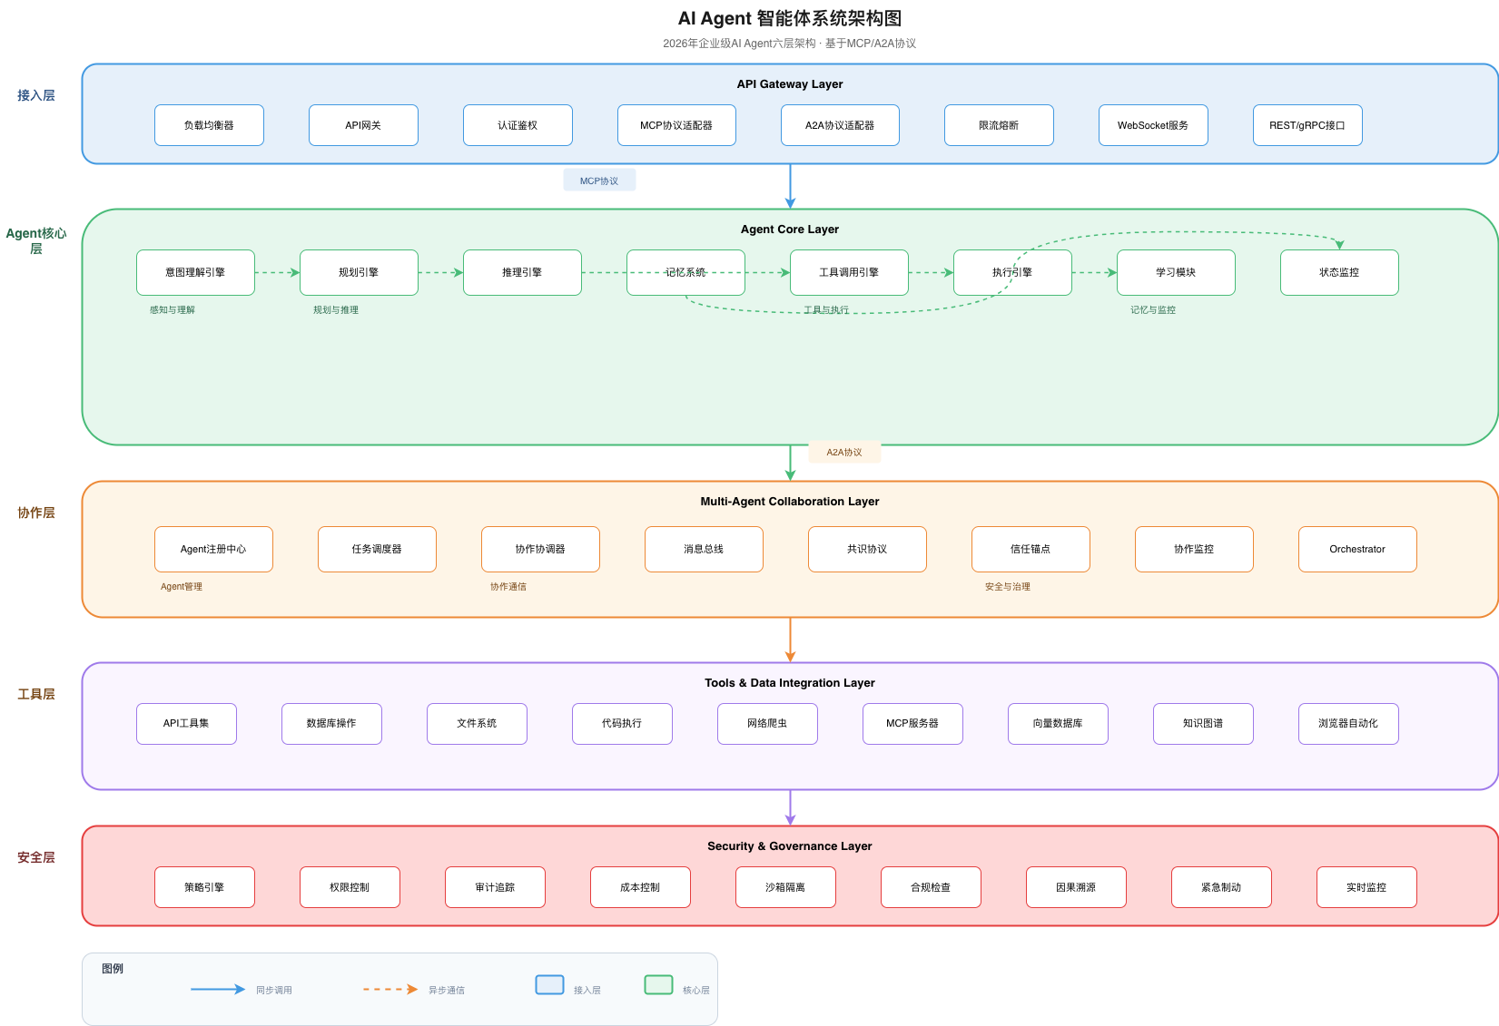

Production-Grade AI Agent System Architecture
Access Layer: Unified Interaction Entry
As the system's interface with the outside world, it provides standardized API gateways, authentication, and multi-protocol adaptation capabilities to efficiently manage user and service requests, ensuring access stability and compatibility.
Agent Core Layer: Intelligent Logic Hub
Undertakes the core intelligent capabilities of the Agent, including intention understanding, planning, memory, and tool calling, serving as the core unit for autonomous task execution and reflecting the Agent's intelligent behavior.
Collaboration Layer: Multi-Agent Collaborative Scheduling
Responsible for collaboration between multiple Agents, communication coordination, and conflict resolution. Through negotiation mechanisms, it integrates decentralized Agent capabilities to achieve complex task division and collaboration, improving overall system efficiency.
The architecture diagram intuitively shows the complete technical chain from external request access to internal security governance, modularizing and layering complex AI Agent capabilities to ensure the system's scalability and security.
Tools & Data Layer
Provides the Agent with callable external tools and multi-source heterogeneous data, achieving infinite expansion of capabilities and efficient data fusion.
Security Governance Layer
Run through the entire system, covering authority control, audit trails, and comprehensive security management to ensure the system's operation is safe and controllable.
Notes:
这张图展示了一个典型的生产级AI Agent系统架构。我们可以看到，Harness的六大组件被有机地整合到了接入层、核心层、协作层、工具数据层和安全治理层中。这直观地说明了Harness Engineering如何将一个AI模型，打造成一个功能强大、结构完整、安全可靠的生产级系统。

Slide 24


Thank You
Harness Engineering transforms AI from an intelligent 'brain' into a reliable 'employee', opening a new chapter in engineering paradigms. Thank you for your attention. Let's explore the infinite possibilities of AI engineering together.
Notes:
总结来说，Harness Engineering代表了AI工程的成熟，它将AI从一个聪明的“大脑”，变成了一个可靠的“员工”。希望今天的分享能帮助大家更好地理解和应用这一新范式。我的分享到此结束，谢谢大家！

